Slide 1
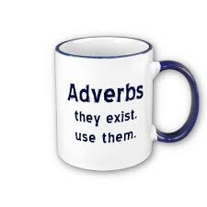

Unit 2
adjectives and adverbs

Slide 2

Adjectives
An adjective says something about a noun.
Examples: a nice person
a good book
old friends

Slide 3
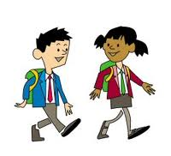
Adverbs
Adverbs say something about a verb.
They ad someting to the verb.
Examples:
We walk to school. - We walk to school daily.
We stopped working. - We stopped working suddenly.
We run. - We run fast.

Slide 4

Form of adverbs
Regular = adjective + ly
Examples: quick – quickly
sad – sadly
nice – nicely

Slide 5
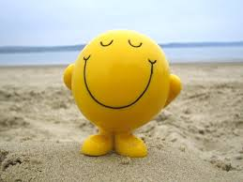
Form of adverbs
If the adjective already ends in – y, you replace the –y by – ily
Examples: noisy – noisily
happy - happily

Slide 6
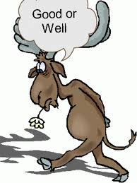
Form of adverbs
- Irregular: good – well
Examples: He is a good cook.
He cooks well.
- Some adjectives never change: fast / hard
Example: He is a fast runner. / He runs fast.

Slide 7
How and why?
The meaning of a saying can change if you use an adjective or an adverb.
verb | used with an adjective | used with an adverb
look | look good (= appearance) | look well (= healthy)
feel | feel good (= state of health/mind) | feel well (= have a good sense of touch)
smell | smell good (= odour) | smell well (= have a good sense of smell)
taste | taste good (= preference) | taste well (= have a good sense of taste)

Slide 8
Online exercises
http://www.englisch-hilfen.de/en/exercises/adjectives_adverbs/adjective_adverb.htm
http://www.englisch-hilfen.de/en/exercises/adjectives_adverbs/adjective_adverb2.htm
http://www.ego4u.com/en/cram-up/grammar/adjectives-adverbs/exercises
http://www.ego4u.com/en/read-on/countries/usa/tour/niagara-falls#exercises
http://www.harcourtschool.com/activity/adverb_trail/index.html

